Slide 1

Tom Cramer
Chief Technology Strategist
Stanford University Libraries
Digital Library Federation (DLF) Forum Denver, Colorado * 4 November 2012

Slide 2
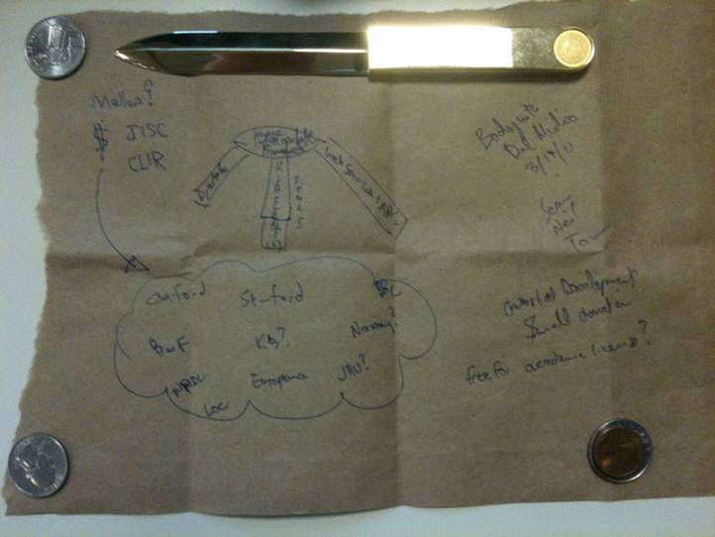
Notes:
An idea is born at dinner after DMS Tech Meeting #3 among the BL, Oxford and Stanford: if it works for Manuscripts, why can’t the same principles and some of the same tools also work for all image based resources. Idea is diagrammed on the (paper) tablecloth.

Slide 3
Image interoperable framework
$, Mellon?, JISC, CLIR
Bodeguita del Medio 3/19/11
Sean Neil Tom
djatoka
Web services + API
Rich Clients
Html 5
Consortial development
Small donation
Free-for- academic license?
Oxford, BnF, NPDL, LoC, Stanford, KB?, Europeana, BL, Norway?, JHU
Notes:
An idea is born at dinner after DMS Tech Meeting #3 among the BL, Oxford and Stanford: if it works for Manuscripts, why can’t the same principles and some of the same tools also work for all image based resources. Idea is diagrammed on the (paper) tablecloth.

Slide 4
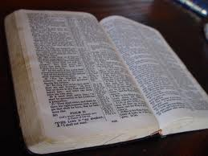
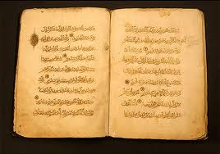
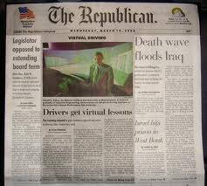
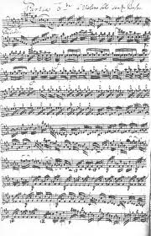
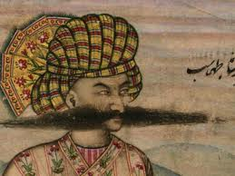
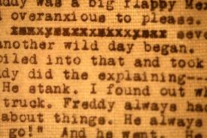
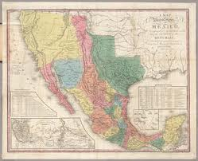
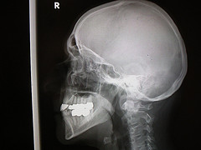
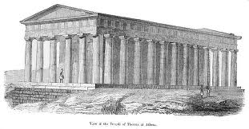
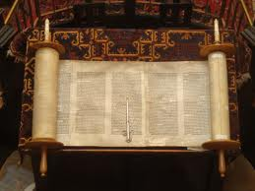
IIIF: Extend DMS To…
Books
Manuscripts
Newspapers
(Sheet) Music
Art / Vis. Resources
Archival Materials
Maps
Scrolls
STEM Imagery
Architecture
Notes:
There are bright spots: SeaDragon, Deep Zoom, ChronoZoom, Djatoka, GoogleArt

Slide 5
Because Digital Image Delivery is…
…too hard
…too slow
…too expensive
…too disjointed
…too ugly
…and we <repositories, software developers, users, funders> suffer because of it.
Notes:
There are bright spots: SeaDragon, Deep Zoom, ChronoZoom, Djatoka, Google Art Project, Gallica, National Library of Norway newspaper viewer

Slide 6
Consider
…a paleographer who would like to compare scribal hands from manuscripts at two different repositories
…an art & architecture instructor who would like to assemble a teaching collection of images from multiple sources
…a humanities scholar who would like to annotate a high resolution image of an historical map (but her preferred annotation tool only is deployed against other sites)
Notes:
DMS Tech is a Mellon Funded project

Slide 7
Consider
…a repository manager who would like to drop a newspaper viewer with deep zoom into his site with no development or customization required
…a funder who would like to underwrite the digitization of a new scholarly resource, but doesn’t want to pay for the development of yet another, stand-alone, digital collection web site from scratch
Notes:
DMS Tech is a Mellon Funded project

Slide 8







IIIF Participants*
Bibliothèque nationale de France
The British Library
Cornell University
Los Alamos National Library
National Library of Norway
Oxford University
Stanford University with latter day contributions from
ARTStor
The National Archives (UK)
* With support from the Andrew J. Mellon Foundation

Slide 9
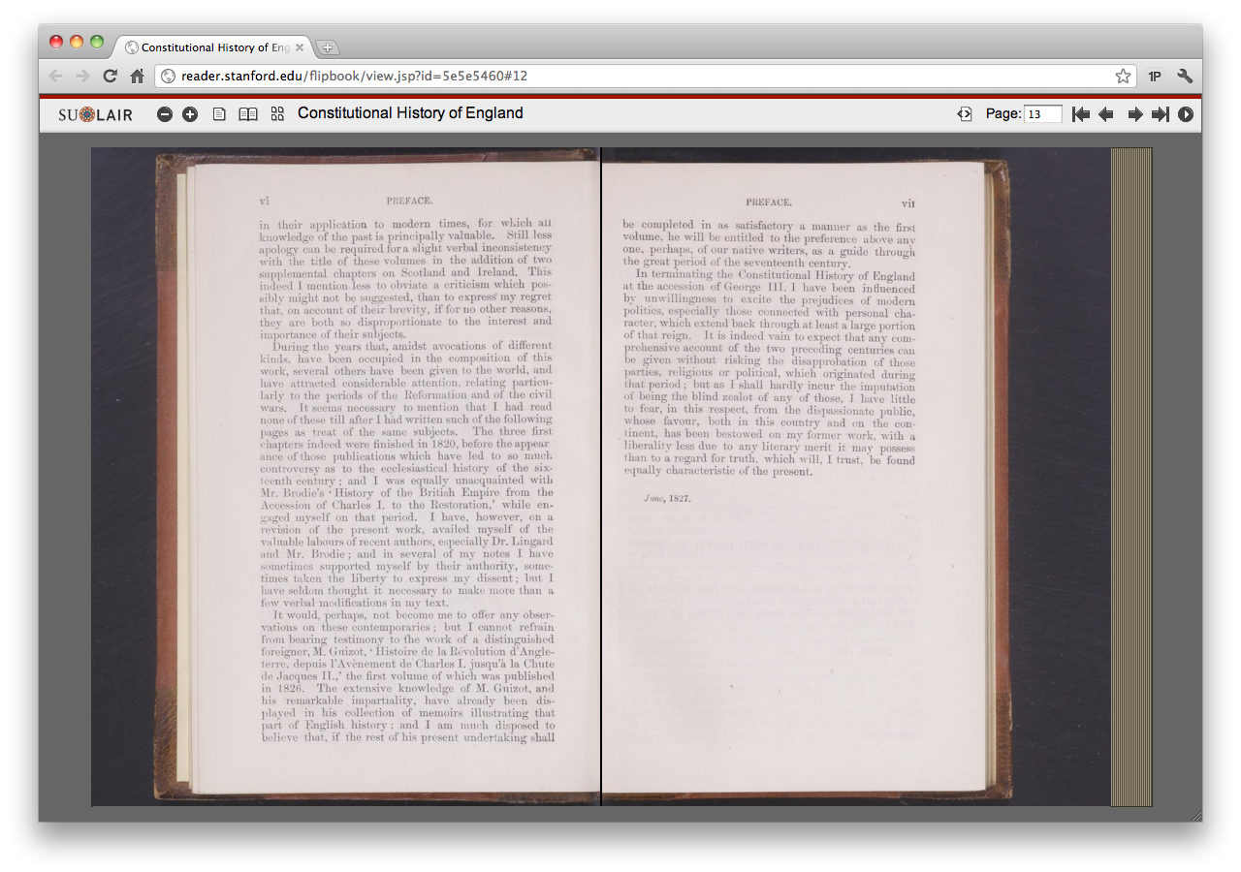
Stanford University
Notes:
Stanford’s Book Reader (based on the Internet Archive book reader).

Slide 10
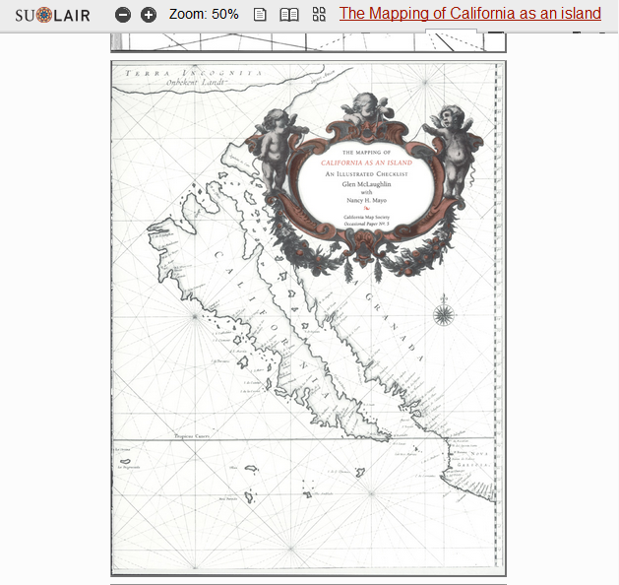
Stanford University
Notes:
Stanford map viewer.

Slide 11
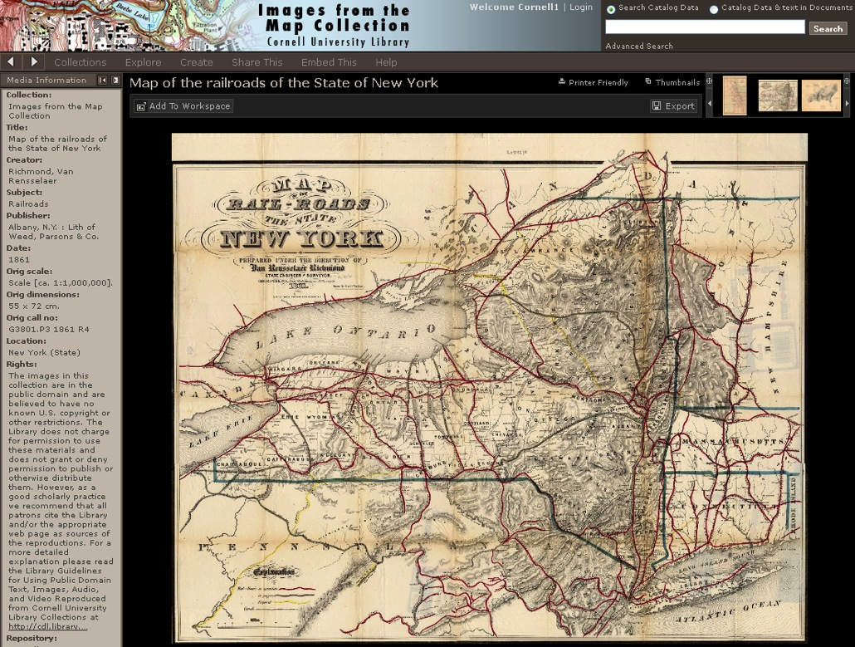
Cornell University
Notes:
Cornell map viewer.

Slide 12
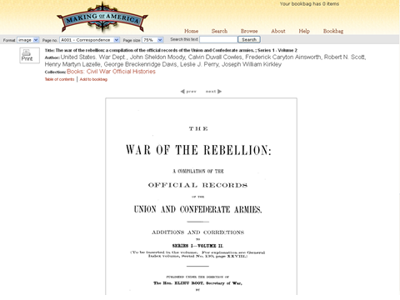
Cornell University
Notes:
Cornell book reader (based on DLXS)

Slide 13
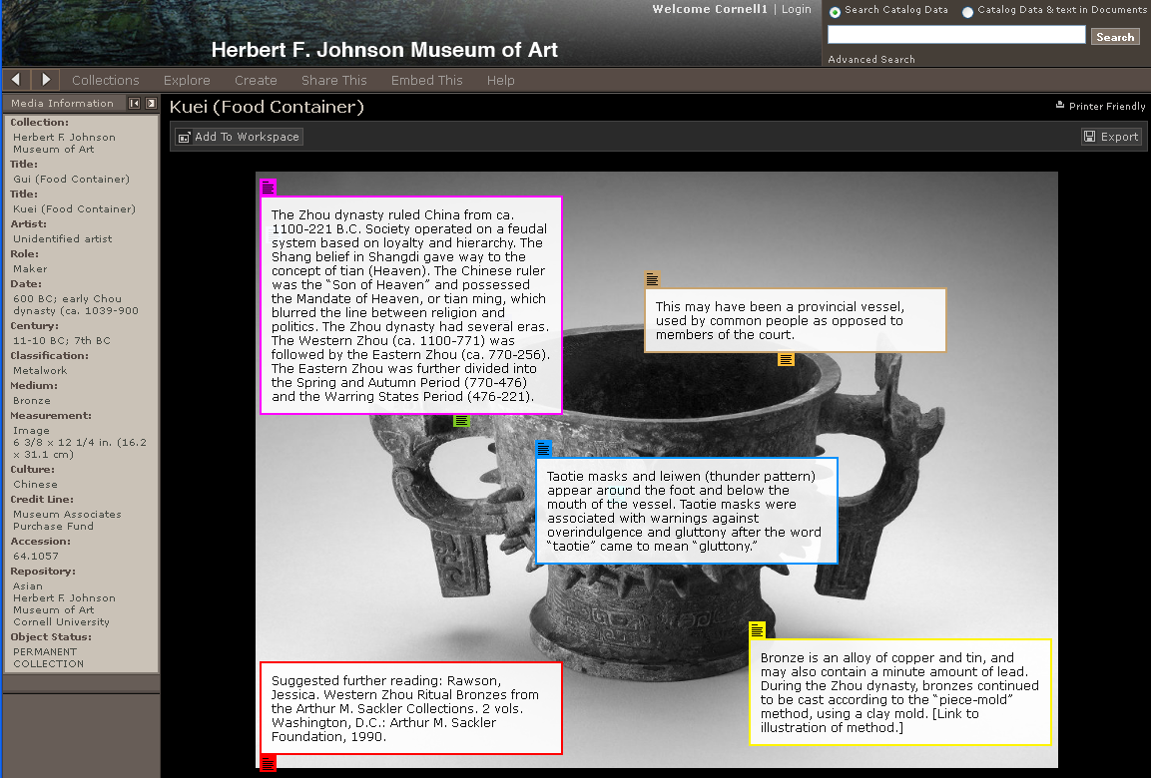
Cornell University
Notes:
Cornell annotated art collection, hosted in Luna.

Slide 14
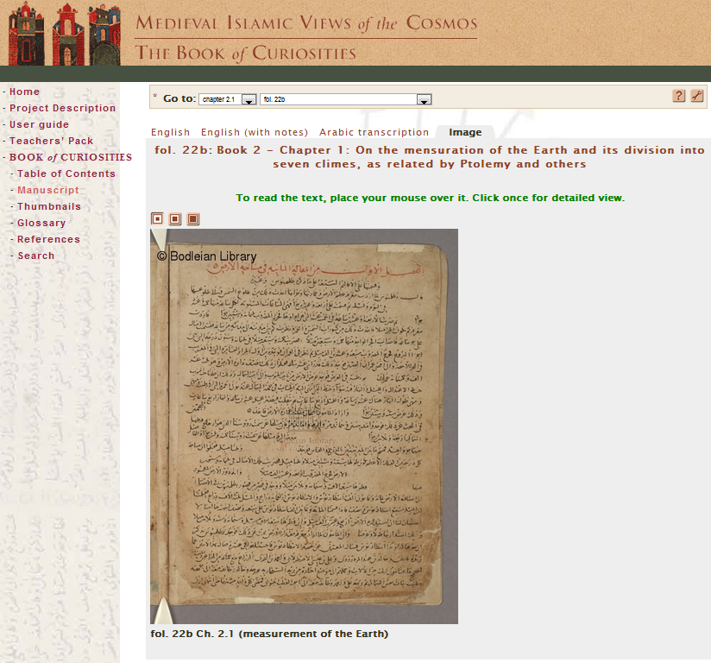
Bodleian Libraries
Notes:
Oxford one-off manuscript viewer.

Slide 15
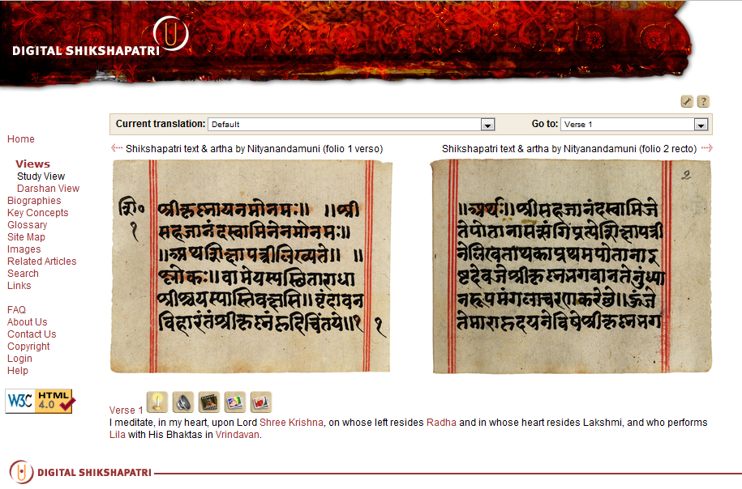
Bodleian Libraries
Notes:
Oxford one off viewer.

Slide 16
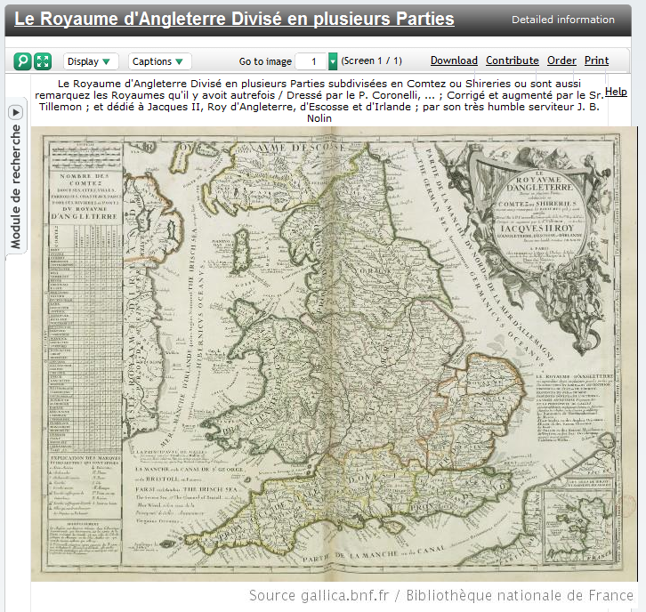
Bibliothèque nationale de France
Notes:
Gallica from BnF

Slide 17
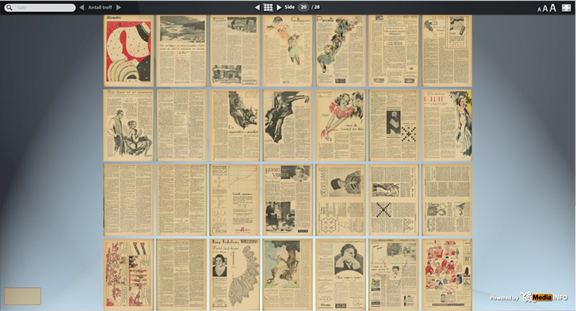
National Library of Norway
Notes:
MediaInfo newspaper viewer from Nat’l Library of Norway.

Slide 18
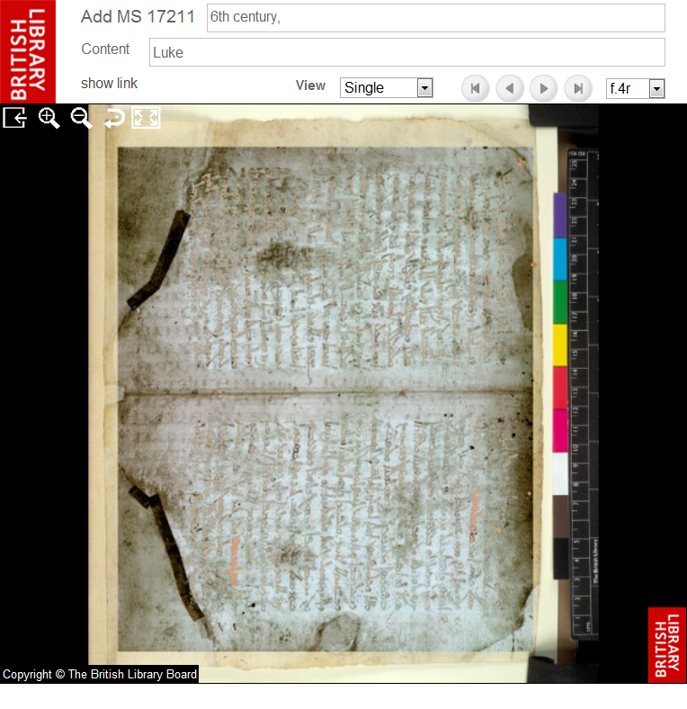
British Library
Notes:
British Library MSS viewer.

Slide 19
Digital Medieval Manuscripts Today: A World of Silos & Duplication
Every repo a silo (→ no interoperability)
Every app a one-off (→overhead to code and keep)
Every user forced to cope (→ many UIs, little integration)
Notes:
The repositories and applications providing access to Digital Medieval Manuscripts in today’s environment are heavily silo’ed, with access to each repository provided through one off applications. This is a microcosm of the wider world of access to image based scholarly resources.

Slide 20
Distinct Concerns
Build useful tools and apps
Want: Users & resources
Scholars
Tool Makers
Find, Use, Analyze, Annotate
Want: Mix & Match, Best of Breed
Repositories
Host, Preserve (and Enrich) Resources
Want: Use of Resources, Enriching services, Enriched content
Notes:
The repositories and applications providing access to Digital Medieval Manuscripts in today’s environment are heavily silo’ed, with access to each repository provided through one off applications. This is a microcosm of the wider world of access to image based scholarly resources.

Slide 21
API’s Enable Reuse
Notes:
API’s to access image and description from a repository enable access to content from other applications and systems for viewing or analytics (transcription, annotation, e.g.) Some of this data could be reimported to the repository for reuse by others (e.g., transcriptions).

Slide 22
API’s -> Framework -> Ecosystem
Notes:
If multiple repositories supported the same API’s for access to images, metadata and annotations, one can envision the beginnings of a framework with shared application code across different sites, and interoperable image-based resources, enabling simultaneous access to multiple scholarly repositories through a single interface.

Slide 23
IIIF Objectives
Define APIs for
Image Delivery
Metadata (to drive image presentation)
Search (to drive image-based interactions)
Trial API adoption (for proof of concept)
Catalyze software development
Zoomers, Viewers, Page Turners, Anno tools
Figure out what to do with Djatoka
Establish an ongoing effort

Slide 24
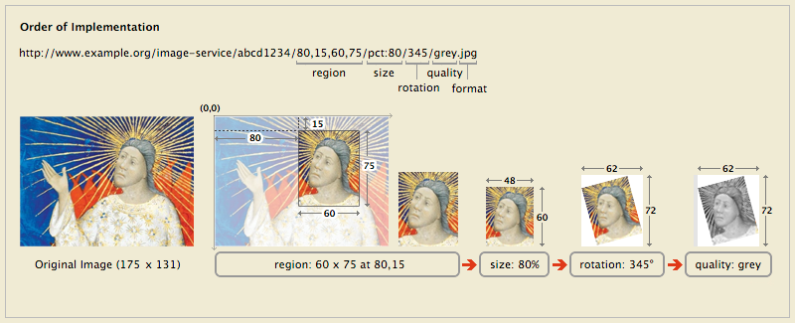
IIIF Image Delivery API
http://library.stanford.edu/iiif/image-api

Slide 25
IIIF Image Delivery API
http://library.stanford.edu/iiif/image-api

Slide 26
IIIF Metadata
Just enough metadata to drive interoperable image delivery
labels, title, sequence, attribution, etc.
Based on http://shared-canvas.org
Synthesis of OAC (Open Anno. Collab.) and DMS
Relate parts of image-based resources
Images, Text, Annotations, Transcriptions, Sequence / Structure
Good URI’s for linking data
Support for annotation tools & initiatives
Open Annotation Collaboration

Slide 27
IIIF Search
Scope = Search within an object
Enough functionality to drive an interoperable viewing environment
Support for full text hits with coordinates for hit-highlighting
Work in progress: substantial overlap with metadata API

Slide 28
Software Tiers from a IIIF View
Tier
Functionality
Implementations
Domain & Modality-specific Delivery Apps
Page Turners,
Scroll Viewers
Gallery Views, Cover Flow
Show All & Zoom
IIP Client
MediaInfo (Norway)
IA BookReader
Etc.
Image Clients
(Deep) Zoom
Pan
Rotate
IIP Client
SeaDragon / SeaJax
MediaInfo (Norway)
ZPR (Stanford)
Authentication & Authorization
IIIF Image API
Image Server
(Tiled) Image Delivery
Djatoka

Slide 29
IIIF Software Wishlist
Performant, community-supported djatoka (or equivalent)
Super-slippy suite of zoom-pan-rotate clients
“Next generation” page turners, cover flow & gallery view clients
Comparative and analytic tools
multi-up, annotation, transcription
Open source AND Commercial solutions

Slide 30
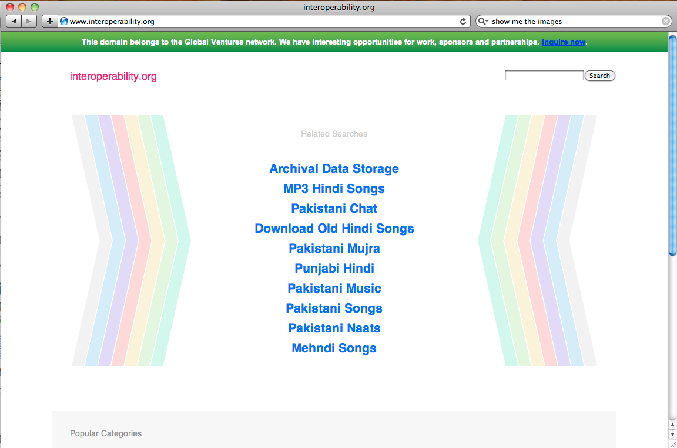
Resource Interop: Images
Web Application – Institution A
Image 1
Institution A
Image 2
Institution B
Image 3 Institution C
“Virtual” Collection of Distributed Resources, e.g.,
Teaching Collection
Cross-Repository Search
Personal Research Resources Collected from the Web
Image 4
Institution D
Image 5
Institution A
Image 6 Institution D
DescMD & Deep Link for Resource 6 via IIIF MD API
Web App – Institution A

Slide 31
Resource Interop: Viewers
Web Application – Institution A
MS Image 1
Institution D
MS Image 2
Institution B
+
S Image 1
stitution D
_
Book Reader Software - Tool Maker X
Deep Zoom Client -- Tool Maker Y
Web App – Institution A

Slide 32
Resource Interop: Analytic SW
Web Application – Institution A
Map Image 1
Institution D
Map Image 2
Institution E
Annotation Tool
Xcription Tool
Georeferencing Tool
Map Image 3
Institution B
Map Image 4
Institution D
Image Analytics Tools
MultiUp Comparison Viewer - Tool Maker X
Web App – Institution A

Slide 33
Timeframe
One year planning effort: Sept 2011 – Aug 2012
3 workshops (Sept, Apr, July)
Dissemination events
Next steps
Deploy it
Test / Prove it
Develop software that leverages it
Expand it
Sustain it

Slide 34
So what’s the IIIF?
Spec some API’s
Expose some resources
Build some software
Establish a community

Slide 35
IIIF and You
Deploy the image API
Help spec/test the metadata & search API’s
Work with us on API-compliant software
Djatoka (or replacement), Zoomers, Viewers
Share use cases
Join the group for the next phase of work…

Slide 36
Home Page: http://lib.stanford.edu/iiif
Announce Email List: iiif-announce@googlegroups.com
Discuss Email List: iiif-discuss@googlegroups.com

